Slide 1
Graphing in R with ggplot2 and plotly

Slide 2
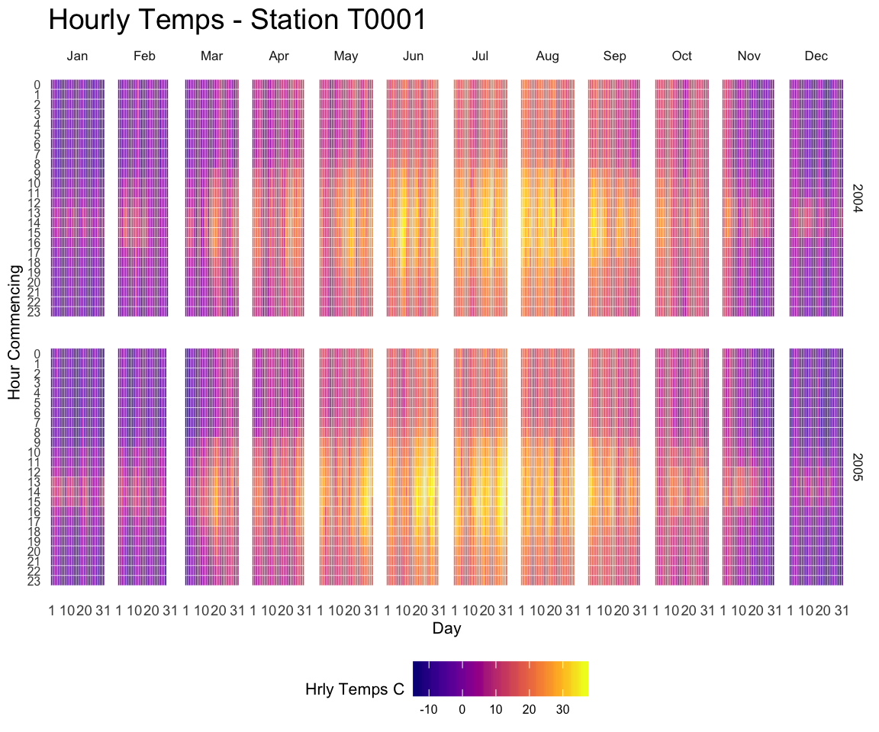
Why ggplot2 instead of excel?
Visualisation is imperative for analysts to communicate the message to non-analysts. It helps if graphs are clear and attractive. However, in some cases graphs needs to display complex information above and beyond what is easily achievable in excel
Data visualization with R and ggplot2 | the R Graph Gallery (r-graph-gallery.com)

Slide 3
ggplot2
Area
Geom
Common include geom_bar, geom_line, geom_point
Data
Add your data to the geom area
Appearance
theme function
Detail
Detail
Data
Detail
Detail

Slide 4
What that looks like in R
ggplot(data = <DATA>) +
<GEOM_FUNCTION>)
mapping = aes(<MAPPINGS>),
stat = <STAT>,
position = <POSITION> +
<COORDINATE_FUNCTION> +
<FACET_FUNCTION>

Slide 5
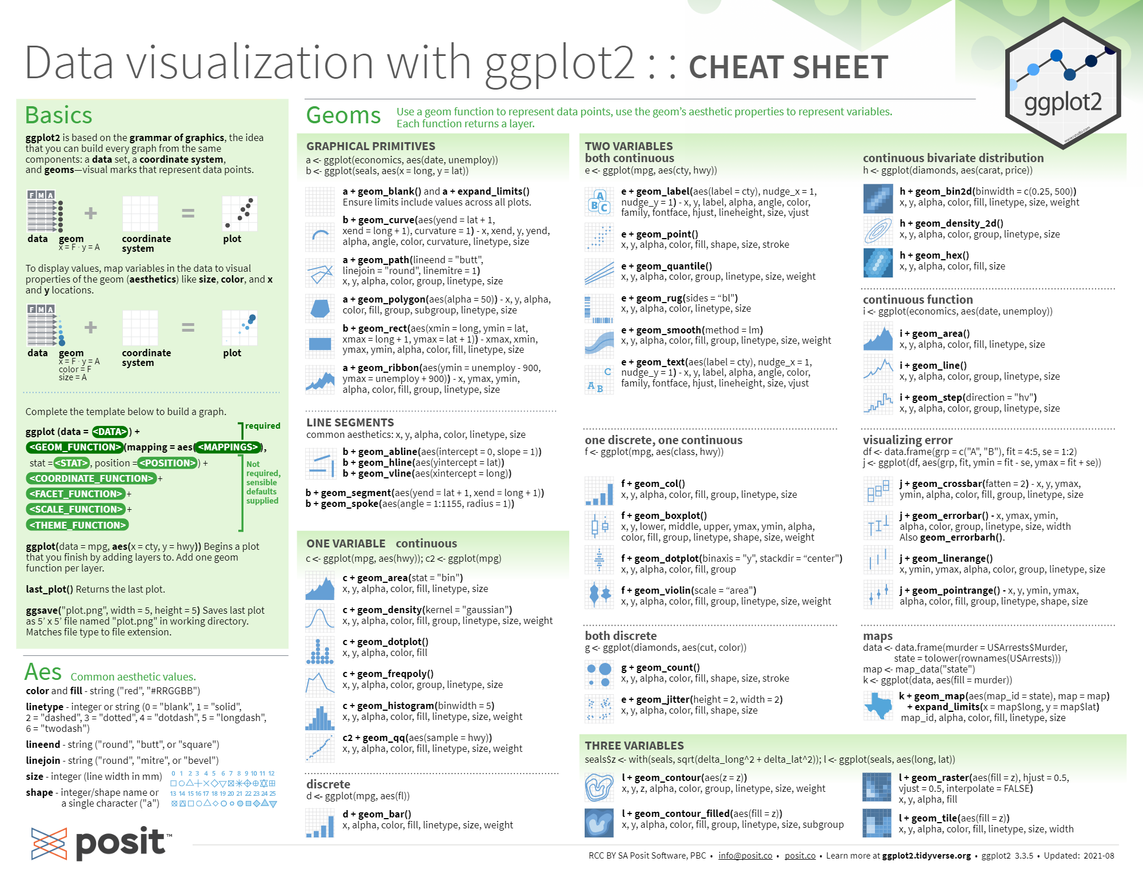

Slide 6
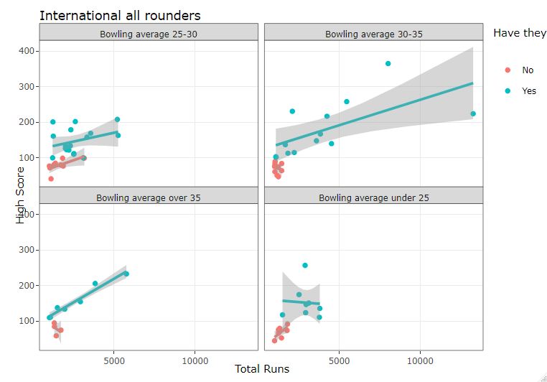
plotly
Another package promoting graphics in R. The big difference between plotly and ggplot2 is the ability of plotly to be interactive
Which you use is a personal preference
Plotly now has a wrapper to allow graphs created in ggplot2 to be interactive
Can be published in HTML

